Slide 1
Chapter 19 To 21
Electrostatic Field in Vacuum
Electric Field and Its Principle of Superposition
Gauss’s Law and Its Applications
Electric Potential and Its Principle of Superposition
Loop-law and Its Applications

Slide 2
19-1. Coulomb's Law (P460)
With the torsion balance (扭称实验)Coulomb (French scientist) in 1785 was able to establish the Coulomb’s law of electrostatic interaction:
The force between two point charges at rest was inversely proportional to the square of the distance between them and proportional to the product of the charges.
y
F₁₂
+q₁
r₁₂
+q₂
r₁
r₂
F₂₁
0
x
z

Slide 3
k is a proportionality constant. The choice of the numerical value and dimensions of k is arbitrary.
单位制的有理化
Dielectric constant in vacuum (真空介电常量 真空电容率)
q₁
q₂
A “point charge” should be:
r
d

Slide 4
Description:
(1) It is an exp. Law, holds both for macroscopic & microscopic, only holds for “point charge” model.
(2) There are four basic physical quantities for electromagnetic quantity in the SI system. They are length (m), mass(kg), time(s), current(A). Read book of page 461.
(3) Still another parallel between the and is that both obey the principle of superposition.
Vector sum

Slide 5
(4) Electric charge is an intrinsic characteristic, as mass, of the fundamental particles making up everyday objects.
(5) Electric charge is quantized (discrete)
q=ne, where n = ±1, ±2, ±3, …
and elementary charge,
(6) Electric charge is conserved. They obey a conservation law —— general principle of physics.
The above is the main contents in our textbook of Sec. 19-1 to Sec. 19-5 (P456-464).

Slide 6
19-2. Electric Field
Question:
Coulomb’s interaction is at a distance. How does q₁ “know” of the presence of q₂? How the force of q₁ acts on the point charge q₂?
1. The electric field (P464)
In the 19th century, British experimental physicist Michael Faraday proposed the electric field.
electric Field 1 electric Field 2
charge q₁
charge q₂
vector field
It is similar to gravitational field！

Slide 7
The basic feature of electric field:
♦ Giving an acting force to any charge in it (对放其内的任何电荷都有作用力) .
♦ The electric force does work on moving charge (电场力对移动电荷作功) V .
Two main tasks:
♦ Calculating the electric field produced by a given distribution of charge.
♦ Calculating the force that a given field exerts on a charge placed in it.

Slide 8
To define at point P due to the charge
object Q,
we measure the electrostatic force that acts on the test charge as:
(electric field)
Question: Does the net electric field depend on
the magnitude of the test charge
?
No! The electric field depends only on the “field charges” and their distribution. The presence of test charge does also not alter the electric field.
Electric field is a vector function of space
its SI Unit:
or

Slide 9
2. The calculation of electric field (P465)
(1) Electric field of a single point charge
q₀
场源点电荷q
Unit-vector of :
E
r
+
(a) ,spherical symmetry.
E
(b) 从源电荷指向场点.
r
(c) 场强方向:正电荷受力方向.

Slide 10
(2) The Electric Field Due to a Few Point Charges:
From the principle of superposition of :
definition:
or
—— The Principle of superposition of
If there is a distribution of electric charges (whether they are discrete or continuous), the net electric field is the vector sum of that of all charges.

Slide 11
A Special Case (P475-):
Two charged particles of magnitude q but of opposite sign separated by a distance d, such a configuration is called electric dipole (电偶极子).
The concepts of electric dipole are often referred to as polar molecules as stated in p475-476. Read this part after class.
-q
+q
p
d

Slide 12
Question:
?
How to calculate produced by a dipole
i.e. The electric field at the point P, perpendicular bisector to the dipole axis (电偶极子中垂线) (P476).
y
α
B(0,y)
Solution:
r₋
r₊
-q
α
+q
o
z
d

Slide 13
y
α
B(0,y)
r₋
r₊
-q
α
+q
Under condition that B is far away from O, (binomial expansion)
O
z
d

Slide 14
Explanations:
(a) E for a dipole varies as 1/r³ for all distant points, regardless of whether they lie on the dipole axis; here r is the distance between the point in question and the dipole center (P477).
.
(b) The product qd, involves two intrinsic properties q & d of the dipole, is defined a vector quantity called electric dipole moment (电偶极矩), which is a basic property of a dipole.
q
+
q
+
electric dipole moment
d

Slide 15
(3) Electric field calculations for any continuous charged distributions (P468)
We can divide up the charged body into dq, each of which acts as a point charge. Then by using the superposition of electric field to write
Q
dq
p
♣ 体DC
Density of charge (DC):
♣ 面DC
♣ 线DC

Slide 16
Example (similar to the case in P469):
A thin nonconducting rod of finite length L has charge q spread uniformly along it. What is the magnitude E of the electric field at point P where is from the rod d (linear DC: +λ)?
y
Solution:
θ
p
θ
x
dq
0
x

Slide 17

or
The result can be simplified for some special cases as:

Slide 18
(a) For infinite charged length of rod
or, y << L, in the vicinity of the charged rod:
(无限长均匀带电细棒)
Direction: perpendicular to and away from the rod.
(b) For half-infinite charged length
(半无限长均匀带电细棒)
(c) If y >> L, far away from the rod:
(electric field of point charge)

Slide 19
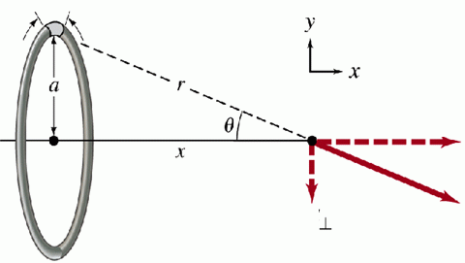
Example (P469):
A thin ring of radius a with a uniform +λ around its circumference.
To calculate the electric field on the axis
of the ring, we define a charge element
Considering the symmetry, we have only x component
dl
dE
dE

Slide 20
That is,
(charged ring)
1
If Q > 0, along +x direction. If Q < 0, along -x direction.
2
Point charge?!
If x >> a, then we have
(Charged ring at a great distance)

Slide 21
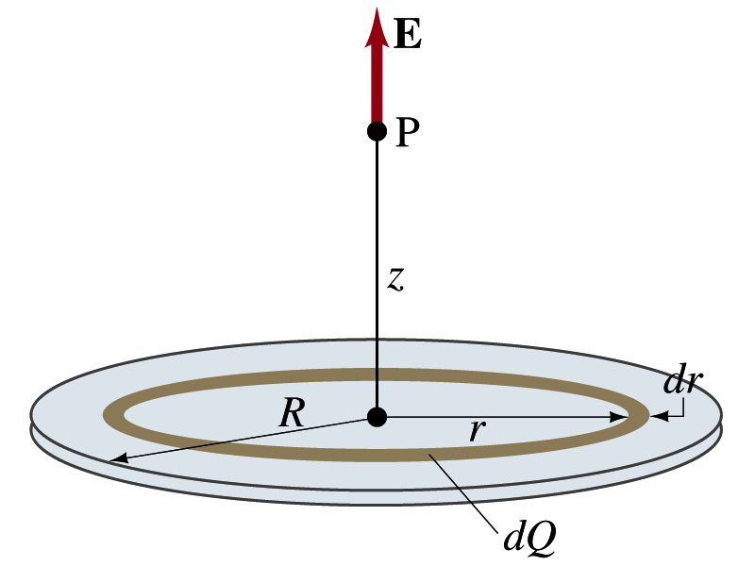
Example (P470):
Below figure shows a circular plastic disk of radius R that has a positive surface charge of uniform density σ on its upper surface. What is the electric field at point P, a distance z from the disk along its central axis?
(Charged disk)

Slide 22
If R→∞ while keeping z finite, it reduces to
1
(infinite sheet)
The E produced by any infinite charged sheet is not related to the distance of z (constant) and its direction perpendicular to the infinite sheet.
z>>R,
2
The disk here is look like a point charge.

Slide 23
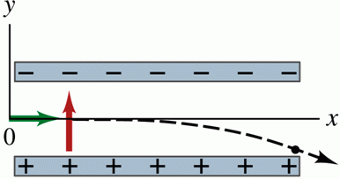
Two main tasks:
♦ Calculating the electric field produced by a given distribution of charge.
♦ Calculating the force that a given field exerts on a charge placed in it.
A charge particle in an electric field (P474):
If a charged point particle q is located in an external electric field , the force on the q by is given by:
P
Study this part
by yourself

Slide 24
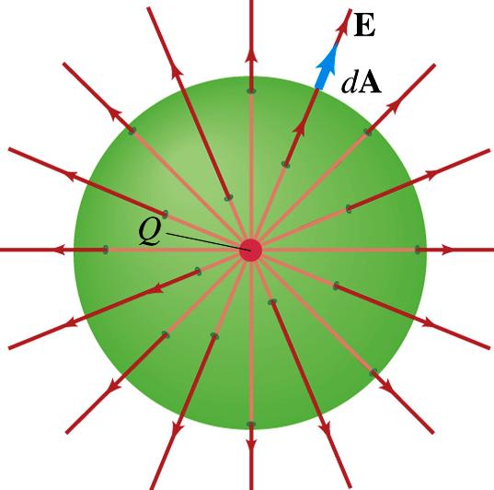
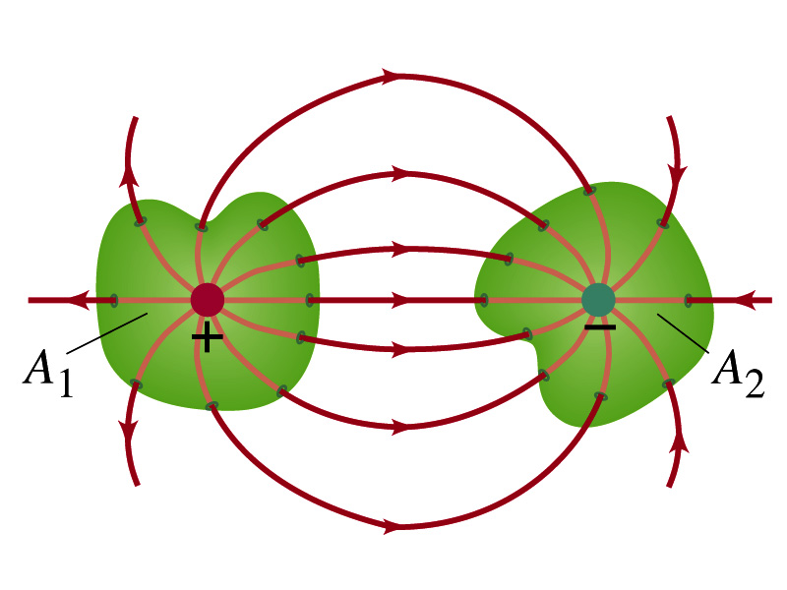
19-3. Gauss’ Law (P486)
1. Electric field lines
By drawing few representative lines that follow the curvature mapped out by the arrows to visualize patterns in electric field.
Hey!
Keep in mind: electric field lines do not actually exist
!

Slide 25
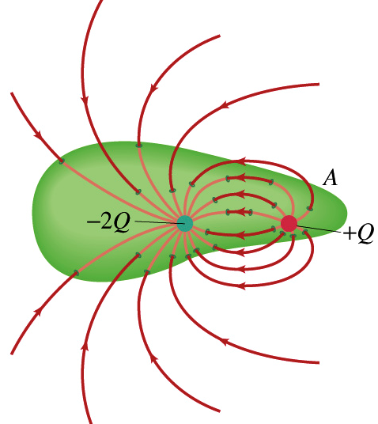
The properties of Faraday’s electric field lines:
(1) Electric field lines originate on positive charges and terminate on negative charges (or go on to infinity). They never originate or terminate on a charged-free point in finite space(不会在没有电荷处中断).
(2) The field lines are never cross each other (otherwise, the electric field at the cross-point has two directions).

Slide 26
2. Flux (通量 )of an electric field (P487)
Defining the electric field (规定电场强度):
Direction: the tangential direction of electric field line at each point in space (电场线上每一点的切线方向).
Magnitude: proportional to the number of field lines per unit area, measured in a plane that is perpendicular to the lines (电场中某点场强的大小等于该点处的电场线数密度，垂直于电场方向的场线数密度).
Uniform
B
C
A

Slide 27
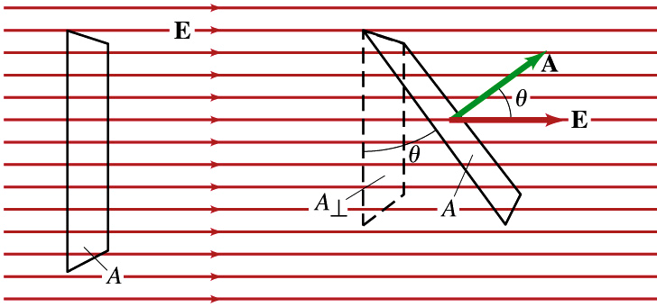
Where is the electric flux —— the number of field lines intersecting the given area (通过电场中任一面的电场线条数⎯⎯通过该面的电通量 ).
Calculating the flux of electric field:
(1) The cases that planes are in the uniform :
The number of electric field line through both area of A and are equal, so

Slide 28
(2) For nonuniform fields and curved surfaces we rewrite this definition of electric flux in differential form:
(electric flux through a Gaussian surface)

Slide 29
Descriptions:
If the surfaces is closed,
According to the convention, , outward the closed surface; inward the closed surface.
If the surface is unclosed, the positive normal direction can be free chosen.
is a scalar. Its SI unit: N·m²/C.

Slide 30
3. Gauss’ law (高斯定理) (P489)
Karl Friedrich Gauss (1777—1835), German mathematician and physicist. He made a lot of contributions in the fields of experimental physics, theoretical physics and mathematics. He made major contributions to the theory of electromagnetism.

Slide 31
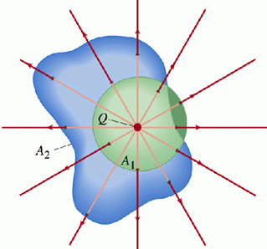
To find out the relation between the electric field and its source, consider a very simple case of a positive point charge q at the center of a spherical shell:
The same result for any shaped-closed surface A₂ due to the continuity of electric field line.

Slide 32
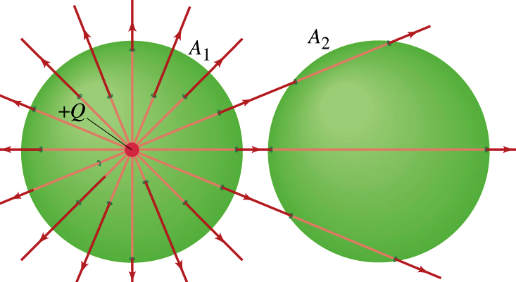
If q is outside of the area, inward=outward, Φ=0
—— Gauss’law for vacuum.
The flux of the electric field through a closed surface of any shape equals to 1/ε₀ times of the algebraic sum of charges enclosed within the surface. 真空中静电场内通过任意闭合曲面的电通量等于该曲面所包围的电量的代数和的1/ε₀倍.
The relation of the source of electric filed and the field 反映场和源 的关系.

Slide 33
Descriptions:
(a) Where is the algebraic sum of all interior charges enclosed in the Gaussian surface. Φ is not related to the way of distribution and outside charges.
(b) The quantity on the left side of above equation is the electric field resulting from all charges, both those inside and those outside the Gaussian surface.

Slide 34
(c) Gauss’s Law and Coulomb’s law are equivalent (see P496). However, Gauss’s Law is hold for the produced by moving charges; Coulomb’s law is only true for electrostatic field.
(d) It give a simple way to calculate the distribution of electric field for a given charge distribution with sufficient symmetry.
4. Applying Gauss’ law——calculating (P491)

Slide 35
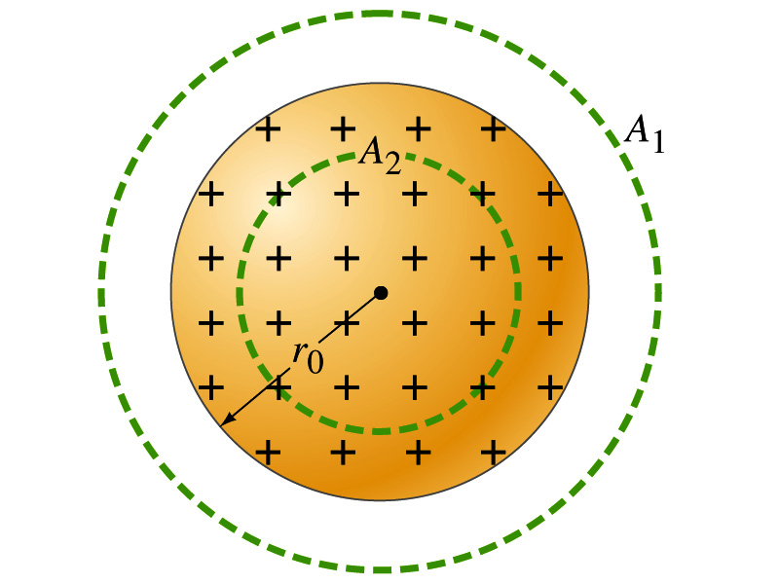
Example 20-4 (P492):
A uniformly charged spherical volume （带电球体）, radius R and total charge Q. Find the at any point of inside and outside region.
?
How do we choose the surface for calculating the electric flux or ?
Question
R

Slide 36
Solution:
To calculate E outside of the sphere, we choose for Gauss’ surface (G. S.) as an imaginary spherical shell A₁ with r > R:
R
using Gauss’law

Slide 37
To calculate E inside of the sphere, we choose for G.S. as an imaginary spherical shell with A₂ r < R:
R
O

Slide 38
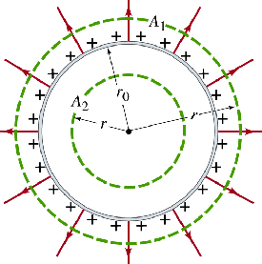
In the similar way, we can get of spherical shell （带电球壳的电场）(P491).
O
r

Slide 39
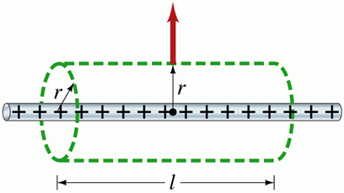
Example 20-5 (P493):
A section of an infinitely long cylindrical plastic rod with a uniform +λ. Let us find an expression for the magnitude of the at a distance r from the axis of the rod.
Solution:
Our Gaussian surface should match the symmetry of the problem ——axis symmetry (轴对称性) or cylindrical symmetry.
场强沿垂直轴线的方向；距中心同远处场强相同

Slide 40
(line of charge)
The direction of is radially outward from the line of charge for +λ, and radially inward for -λ. It also approximates the field of a finite line of charge, at points that are not too near the ends (l >> r).

Slide 41
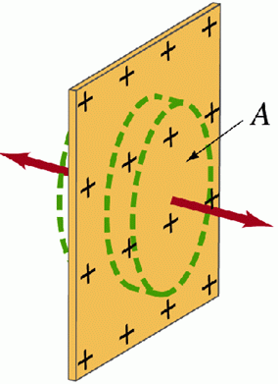
Example 20-6 (P493):
A portion of a thin, infinite, non-conducting sheet (无限大均匀带电平面) with a uniform (positive) surface charge density σ. Find the a distance r in front of the sheet.
Solution:
Planar symmetry—— 垂直板面向外, 距板同远处E大小相同
(sheet of charge)

Slide 42
Discussion:
If we arrange two infinite plates, with uniform opposite σ, to be close to each other and parallel as the figure shown. What are the in the region of A, B and C?
The electric field between parallel-plate capacitor in circuit (直流电路中的平行板电容器间的场强) is such a case.

Slide 43
Summary:
For certain symmetry arrangements of charge (as illustrated cylindrical, planar and Spherical symmetry), Gauss’s law is very much easier to use than integration of field components.
The symmetry of charge distribution is as same as the one of electric field distribution.

Slide 44
19-4. Electric Potential (P502)
1. Features of electrostatic force
Coulomb’s Law for electrostatic force:
Mathematically identical!
Newton’s Law for gravitational force
Many properties for the gravitational may also be true for electrostatic forces.
The electrostatic force is a conservative force.
The work done by electrostatic force is path independent.

Slide 45
Based on the above two points, we can infer that the work done on a moving charge around a closed loop in an electrostatic field is zero.
Circulation theorem
The line integral of the electrostatic field around a closed loop is zero (静电场中场强沿任意闭合环路的线积分恒等于零)⎯⎯ 静电场的环路定理.

Slide 46
2. Electric potential energy (P515)
Because electrostatic force is a conservative force, an electric potential energy U can be introduced:
b
To ensure U at a point, a reference potential energy should be chosen:
a
then
The U of charge q at arbitrary point a = the work done by the during the move of charge q from a to infinity. (q在电场中a点的电势能=q从a移到无穷远电场力所做功).

Slide 47
3. Electric Potential (P502)
The physical quantity to represent property of field at any point —— electric potential.
(electric potential at point a)
When q =1,
V_{a} equals to in magnitude work done by the on unit positive charge during the move from a to infinity along any path. (电荷q在电场中某点电势V_{a}在数值上等于单位正电荷从a移到无穷远处静电场力所做的功亦等于放在点a的单位正电荷所具有的电势能).

Slide 48
Explanations:
(a) The difference of V and U:
V is a property of an electric field, regardless of whether a charged object has been placed in that field; U is an energy associated with a system (the charged object plus the charged particles that set up the electric field).
(b) Unit & dimension of V and U:
V is a scalar. It is measured in joules per coulomb, or volts (V) (1V=1J/C); dimension is . U is measured in joules (eV in P515).

Slide 49
(c) Electric Potential Difference ΔV (电势差,电压)
The ΔV between any two points a and b equal to in magnitude work done by the on unit positive charge during the move from a to b.
ΔV is independent on the choice of reference potential (电势的零点无论选在何处.电势差不受影响).
The value of electric potential is relative, but the one of electric potential difference is absolute (电势的大小是相对的,电势差是绝对的).

Slide 50
4. Calculations of electric potential (P505)
(a) Potential due to a point charge (P507)
From definition of V, integral along radial direction:
P
q
q>0 produces a positive electric potential; q<0, produces a negative electric potential.
(b) Potential Due to a Group of Point Charges
Based on the principle of superposition of :

Slide 51
(c) Potential due to a continuous charge distribution
(d) Principle of superposition of electric potential:
Assume some charges produces at point a:
电场中某点的电势等于各电荷单独在该点产生的电势的叠加(代数和)。
Note: It should be relative to same reference point.

Slide 52
Example 21-8 (P510):
A thin ring of radius R with q uniformly distributing its circumference. What is the V at point P, a distance z from the ring along its central axis (带电圆环轴线)?
Solution:
V
z
O

Slide 53
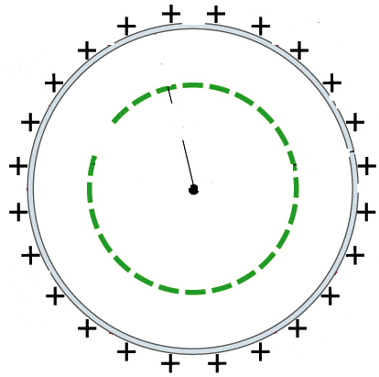

Example:
Calculating potential V for the uniformly charged spherical shell (with charge Q and radius R) .
r
R
球面内E=0!
与电量集中在球心的
点电荷的电势分布相同
V
The distribution of V is continuous.
V_{in} equals to the V at spherical surface.
r
O
R
Spherical shell is a equipotential body (等势体).

Slide 54
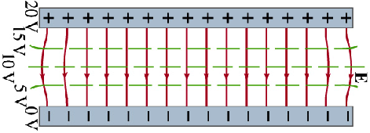
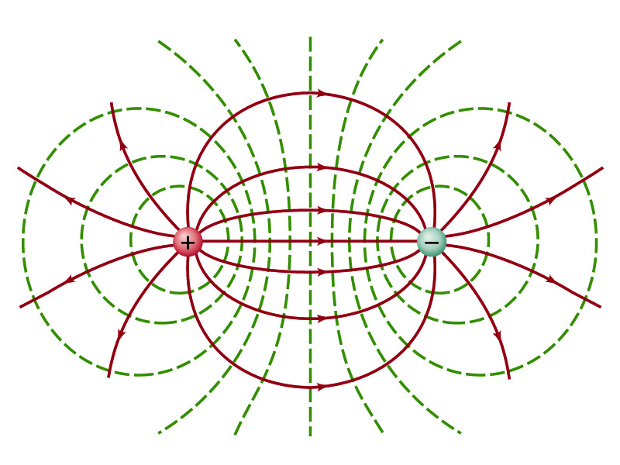
19-5. Relation between V and
1. Equipotential surfaces (P511)
Adjacent points that have the same electric potential form an equipotential surface, .
电势相等的点组成的面
Take as a constant and plot equipotential surface.

Slide 55
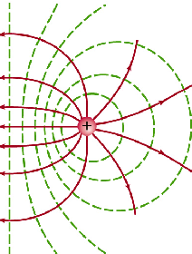
2. Relation between electric field line and equipotential surface
(a) Electric field lines are perpendicular to
equipotential surfaces everywhere.
(b) The direction of electric field lines direct the one of electric potential decreasing (电势降落的方向)放在电场中的正电荷将由高电势处向低电势处运动;负电荷……
(c) The electrostatic force does zero work if charge move along the surface.
(d) The place where the equipotential surfaces are dense has strong electric field (等势面的疏密反映了场的强弱).

Slide 56
3. Electric potential gradient (电势梯度) (P513)
Integral relation —— find V from :
Differential relation——find from V:
That is,
Proof:
As figure, a,b are very near points, is the displacement from a to b.
b
a
I
II

Slide 57
Where,
★ The operator of gradient in the right-coordinate 直角坐标下梯度算符:

Slide 58
Partial derivatives along s direction 沿 方向的变化率(方向导数 )
The component of in any direction is the negative of the rate of change of the electric potential with distance in that direction.
（电场中某点场强沿某方向的分量等于电势沿此方向空间变化率的负值 或电场中某点场强等于该点的电势梯度的负值）。
In SI system, the unit of electric field can be defined as volts per meter. V/m is as same as N/C.

Slide 59
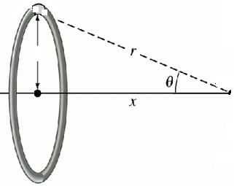

Example (P514):
A thin ring of radius R with a uniform +λ around its circumference. What is the ?
From,
R
P
O
q
V
x
O
It is the the same as what we got before!

Slide 60
Example (P514):
At any point on the central axis of a uniformly charged disk V is given by , from this expression, derive an expression for the at any point on the axis of the disk.
Solution:
It is the same result as what we got before!

Slide 61
The problems of chapter 19:
11, 28, 38, 39, 41, 47, 48, 49, 50, 51, 53
The problems of chapter 20:
1, 4, 8, 13, 18, 19, 21, 22, 23, 24, 27, 28, 29, 33, 34, 36, 43, 47
The problems of chapter 21:
11, 12, 16, 17, 18, 19, 20, 31, 32, 33, 46, 47, 48, 78, 79, 83
The correct answer of problem 79 should be:

